Slide 1
Two big blobs on a page with links to the lo—in page or register page
You’ve got legal
Log-in
Register

Slide 2
What do I need to do?
These are all links on a page to various views
You’ve got legal
What do I need to do?
What am I waiting for from others
All activities
Something’s gone wrong – I need legal help!!!!
Admin

Slide 3
What do I need to do?
These are links to other pages
You’ve got legal
What do I need to do?
What am I waiting for from others
All activities
I need legal help
Admin

Slide 4
What do others need to do?
S
You’ve got legal
Search box
What do I need to do?
Show me only My most pressing obligations Obligations to a particular company Payment obligations
What activity | When by | Because of .. | Where’s it up to?
[Task] | [Due date] | [Agreement] with [insert party] more
I need legal help

Slide 5
You’ve got legal
What am I waiting for from others?
Show me only Obligations by Company
Company Name
Company A
About this company
I need legal help

Slide 6
What do I need to do?
You’ve got legal
Company A
I have [insert number] of agreements with this company. The agreements are:
[insert list]
In the news
By Me
The next things I have to do for this company are:
[insert list]
The most pressing are [insert list]
For me
The next things I have to do for this company are:
[insert list]
The most pressing are [insert list]
I need legal help

Slide 7
Forms-CRUD
user form
agreement form:
will include new company
tasks.

Slide 8
API
Calendar

Slide 9
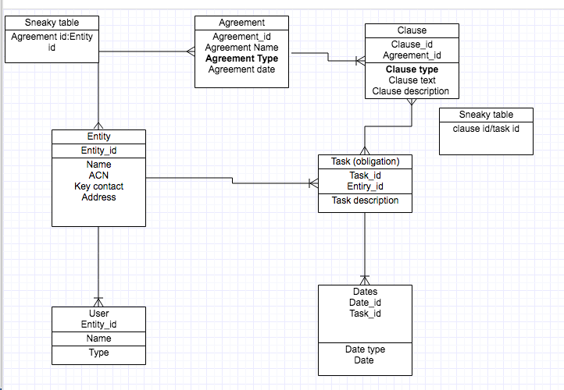
How to handle type – controlled lists eg type. Part of the one table with a controlled list?
rails generate model Entity name:text ACN:integer address: text contact: text contact_number:integer contact_email:text

